Slide 1
AC6761 Artificial Intelligence Accounting
Chapter 4 REA Accounting Model

Slide 2
Traditional Double-Entry Bookkeeping​
Core Principle​​:
Records every transaction with dual entries (debit/credit) to maintain the accounting equation: ​​Assets = Liabilities + Equity​​. It focuses on financial outcomes (e.g., profits, cash flows) and uses standardized financial statements (income statement, balance sheet)

Slide 3
Strengths and limitations
​Strengths​​:
Ensures mathematical accuracy through trial balances.
Simplifies compliance with regulatory standards (e.g., GAAP, IFRS).
Widely supported by software (e.g., QuickBooks) and integrates with tax reporting
Limitations​​:
​​Limited scope​​: Captures only monetary transactions, ignoring non-financial data (e.g., customer satisfaction, production efficiency).
Historical focus​​: Emphasizes past performance rather than real-time operational insights

Slide 4
​​REA Accounting Model: A Paradigm Shift
Core Principle​​:
Models business activities around three core elements:
​​Resources​​ (e.g., inventory, cash, equipment),
​​Events​​ (e.g., sales, purchases, production),
​​Agents​​ (e.g., customers, employees, suppliers).
Unlike double-entry, REA records economic events in their semantic context rather than as debits/credits. For example, a sales event links to the sold resource (product), involved agents (salesperson, customer), and related events (payment, delivery).

Slide 5
Strengths and limitations
Strengths​​:
​​Holistic view​​: Integrates financial and non-financial data (e.g., order fulfillment time, resource utilization), enabling multidimensional decision-making.
​​Process optimization​​: Identifies inefficiencies by mapping event sequences (e.g., bottlenecks in production)
Example: A manufacturing firm using REA reduced costs by 15% by analyzing "resource-event" linkages to eliminate waste
​​Adaptability​​: Supports real-time data analytics and AI-driven forecasting
​​Limitations​​:
​​Complex implementation​​: Requires redesigning databases and training personnel to capture granular event/agent data.
​​Lack of standardization​​: No universal guidelines for REA-based reporting, complicating audits and cross-company comparisons

Slide 6
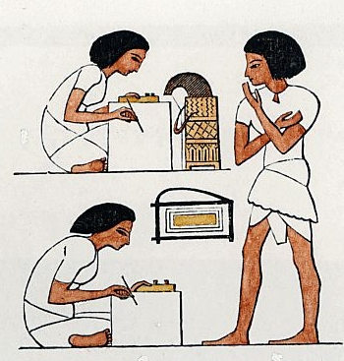



Accounting Systems for Economic Storytelling
Throughout history, accountants recorded and reported the economic stories of enterprises.

Slide 7
Histories
7000 years ago, people of Babylonia touched the concepts of economic value and profit. Record information – making notches in sticks.
1494, the double-entry bookkeeping system was introduced by Pacioli.
After industrial revolution, corporation emerges as financial needs were beyond the ability of most sole traders or partnerships.
The separation between ownership and control in corporation triggered the importance of financial statements.

Slide 8
Criticism
Question: is the information completely and accurately disclosed to information users?
Information users: insiders and outsiders
Double-entry bookkeeping system – mainstream
Accounting information system – different perspective

Slide 9
Re-Inventing Accounting Systems
In 1982, Bill McCarthy published a research article explaining his ideas for re-engineering accounting systems
  He didn’t call it re-engineering, but it was
  He focused on natural phenomena common to most enterprises for various types of transactions.
  He recommended eliminating artifacts such as debits, credits, and accounts
    Artifacts are manufactured, not naturally occurring
    Accounting artifacts obscure details of business transactions needed for non-accounting purposes
  This course explains and discusses McCarthy’s ideas for developing integrated enterprise systems that can satisfy accounting needs while also satisfying needs of other business areas

Slide 10
Bill McCarthy’s example
Double entry bookkeeping system: “cost of goods sold” and “sales revenue” are two distinct accounts.
REA model: the two accounts represent attributes of the same class “sale events”.

Slide 11
Example of
Economic Story Telling
Company A sells products to Company B.
  Company A gives products to Company B.
  Company A gets cash from Company B.

Slide 12
Details
  On Jan 1, 2013, Paul of 7-11 in Festival Walk sold one cookie to customer Joe.
  Paul give a cookie to Joe.
  Paul gets cash from Joe.
Specifics:
  Price was $10
  Cost was $8

Slide 13
Double-Entry System
Paul gives a cookie to Joe.
Account | DR | CR

Slide 14
Double-Entry System
Paul gives a cookie to Joe.
Account | DR | CR
Cost of Goods Sold | 8
Inventory |  | 8
A/R | 10
Sale Revenue |  | 10

Slide 15
Double-Entry System
Paul gets cash from Joe.
Account | DR | CR

Slide 16
Double-Entry System
Paul gets cash from Joe.
Account | DR | CR
Cash | 10
A/R |  | 10

Slide 17
REA
Economic
Resource
Economic
Event
Economic
Agent
  When? Where? What? Who?
Resources: what
Event: what, when, where
Agent: who

Slide 18
Duality
There is usually a pair of events at the heart of REA. One represents a resource being given away or lost, while another represents a resource being received or gained.
Two events are linked – a cash receipt occurs in exchange for a sale, and vice versa.
Could be more complicated – a product conversion occurs in exchange for a usage of raw material, labor cost and overhead.

Slide 19
Economic Resource
Inventory
Inside Agent
Employee
Economic Event
Sale
Outside Agent
Customer
Give
duality
Get
Outside Agent
Customer
Economic Event
Cash Receipt
Economic Resource
Inside Agent
CASH
Employee

Slide 20
Conceptual model
Conceptual model is a representation that depicts the important objects and relationships between the objects that must be captured in a database.
Different conceptual modeling languages: narrative descriptions, diagrams of various types with different notations, XML (Extensible Markup Language), XBRL (Extensible Business Reporting Language)
Universal Modeling Language is a widely accepted notation for system analysis and design.
The class diagrams of UML are appropriate for conceptual modeling of REA concepts.

Slide 21
Logical model
A conceptual model is converted into a logical model once the type of database to be used has been determined.
Examples of logical model include relational, object-oriented, hierarchical, network, and others.

Slide 22
Physical database model
Physical database model is created based on the specific database software package in which the database is implemented.

Slide 23
Conceptual modeling with UML class diagrams
The four constructs: classes, associations, attributes, and multiplicities.

Slide 24
Conceptual Modeling Constructs
Classes: sets of entities (a real world object that has a separate existence, either physical or conceptual) that share the same characteristics.

Slide 25
UML Class Diagrams: Classes
Each class is drawn with a three compartment box.
The first compartment contains the stereotype (if any) and the class name
  A stereotype is a generalized type of class to which other classes may belong
The second compartment contains the attributes of the class
The third compartment contains the operations the class may perform (we will leave these blank)

Slide 26
Conceptual Modeling Constructs
Associations
  Relationships between classes
Association class: there can be only one link between the related entities.
Reified association: there can be multiple links between the related entities.

Slide 27
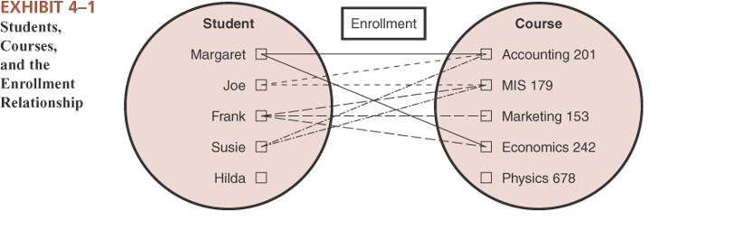
Example Classes and Association

Slide 28
Conceptual Modeling Constructs
Attributes
  Characteristics or elementary properties of classes and/or associations
  Primary key attribute uniquely and universally identifies each instance of a class or association
  Simple (cannot be further decomposed) versus composite attributes (may be decomposed into other attributes)
  Derivable attributes (can be derived / computed from the values of other attributes in the database.
    Static – will not change if new data is entered into system
    Volatile – will change if new data is entered into system

Slide 29
Conceptual Modeling Constructs
Multiplicities: how many times an instance of a class is allowed to participate in an association.
  Minimum: expresses the minimum number of times one instance of a class must participate in an association with the related class.
  0 = optional participation (any specific instance of the class can exist in the database without a corresponding instance of the associated class)
  1 = mandatory participation (must be related to at least one instance)
  Maximum: expresses the maximum number of times one instance of a class may participate in an association with the related class
  1 = one-time only participation
  * = as many times as needed, no restrictions

Slide 30
Examples: Customer, Sale
<<Agent>>
Customer
-customer ID
-name
-address
1..1
0..*
<<economicDecrement>>
Sale
-sale ID
-date
-dollar value
participation
  Customer can participate in the association 0 time.
  Customer can participate in the association multiple times.
  Sale can participate in the association at least once.
  Sale can participate in the association at most once.

Slide 31
Example:
Employee/Department multiplicities
Employees are not necessarily assigned to departments
  Minimum participation of employee = 0 (put next to dept)
Every department has at least one employee assigned to it
  Minimum participation of department = 1 (put next to emp)
An employee can work for no more than one department
  Maximum participation of employee = 1 (put next to dept)
A department may have many employees assigned to it
  Maximum participation of department = * (put next to emp)

Slide 32
Interpret Multiplicities: Exercise 1
Q1: Can at least one sale exist in the database without a related instance of cash receipt?
No – 1 min next to CR
Q2: Can at least one sale in the database relate to multiple instances of cash receipt?
No – 1 max next to CR
Q3: Can at least one cash receipt exist in the database without a related instance of sale?
No – 1 min next to Sale
Q4: Can at least one cash receipt in the database relate to multiple instances of sale?
No – 1 max next to Sale
In other words, all sales are paid for immediately with cash, and sales are the company’s only source of cash

Slide 33
Interpret Multiplicities: Exercise 2
Q1: Can at least one sale exist in the database without a related instance of cash receipt?
Yes – 0 min next to CR
Q2: Can at least one sale in the database relate to multiple instances of cash receipt?
No – 1 max next to CR
Q3: Can at least one cash receipt exist in the database without a related instance of sale?
No – 1 min next to Sale
Q4: Can at least one cash receipt in the database relate to multiple instances of sale?
No – 1 max next to Sale
In other words, sales may be made on credit with no partial payments or combined payments accepted, and sales are the company’s only source of cash

Slide 34
Interpret Multiplicities: Exercise 3
Q1: Can at least one sale exist in the database without a related instance of cash receipt?
Q2: Can at least one sale in the database relate to multiple instances of cash receipt?
Q3: Can at least one cash receipt exist in the database without a related instance of sale?
Q4: Can at least one cash receipt in the database relate to multiple instances of sale?
In other words, sales may be made on credit with partial payments but no combined payments accepted, and sales are the company’s only source of cash

Slide 35
Interpret Multiplicities: Exercise 4
Q1: Can at least one sale exist in the database without a related instance of cash receipt?
Q2: Can at least one sale in the database relate to multiple instances of cash receipt?
Q3: Can at least one cash receipt exist in the database without a related instance of sale?
Q4: Can at least one cash receipt in the database relate to multiple instances of sale?
In other words, sales may be made on credit with partial payments and combined payments accepted, and cash comes from sources other than sales

Slide 36
Relational Database Model
A relational database consists of tables (relations) that are linked together via the use of primary and foreign key (attribute)
  A FOREIGN KEY in a table is a primary key from a different table that has been posted into the table to create a link between the two tables

Slide 37
Relational Database Model
Relational database tables are made up of rows and columns
  Rows are called the table extension or tuples
    Order does not matter
  Columns are called the table intension or schema
    Order does not matter
    Data format does matter (e.g. date, text, currency, etc.)
  Each cell in a database table (a row-column intersection) can contain only one value
    no repeating groups are allowed

Slide 38
Foreign Key Example
SaleID | Date | Amount | Salesperson
061401A | 6/14 | $4,218 | 123456
061401B | 6/14 | $6,437 | 654321
061501A | 6/15 | $1,112 | 654321
SalespersonID | Name
123456 | Fred
654321 | Francis

Slide 39
Relational Database Model
Some principles of the relational model
  Entity Integrity
    A primary key in a table must not contain a null value
  Referential Integrity
    A value for a foreign key in a table must either
      Be null (blank)
      Match exactly a value for the primary key in the table from which it was posted
  One Fact, One Place
    Fact = a pairing of a candidate key attribute value with another attribute value (candidate key attributes are those attributes which can be used as primary key attributes)

Slide 40
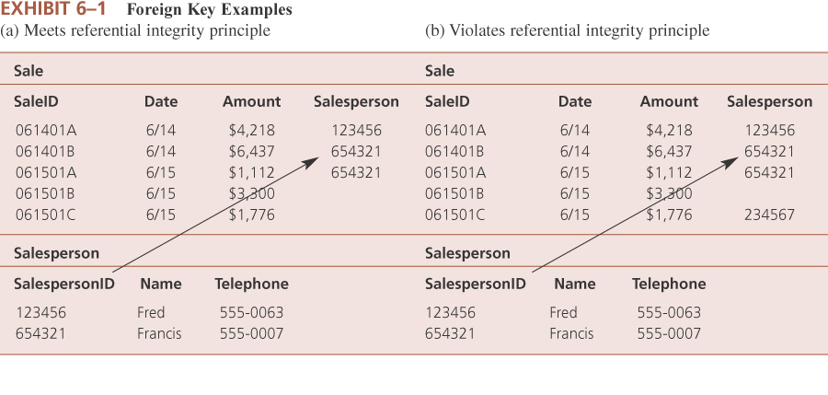
Referential Integrity Example

Slide 41
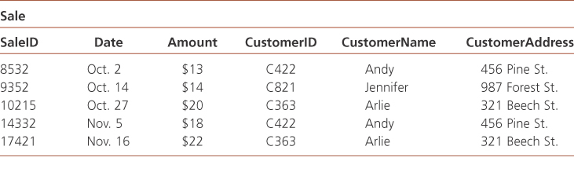
One Fact-One Place Violations
One fact in multiple places

Slide 42
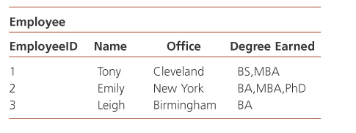
One Fact-One Place Violations
Multiple facts in one place
1
2
3
4
5
Each value of each attribute in a row is paired with the primary key, so if any cell has two or more attribute values, by definition there are multiple facts in one place (also known as a repeating group)

Slide 43
Converting Conceptual to Relational
GOAL: Make as few tables as necessary, and avoid redundancy (repeating groups or one fact multiple places), and minimize null values
Step 1: Create a separate table to represent each class in the conceptual model
  1A: Each attribute of the class becomes a column in the relational table
  2A: Each instance (member) of the class becomes a row in the relational table
Steps 2-5 (detailed in the next few slides) involve determining whether each association in the conceptual model should be represented as a separate table or as a posted foreign key
  Redundancy and Load are important determinants
    Redundancy = one fact in multiple places or multiple facts in one place
    Load = the percentage of non-null values in a column
  Multiplicities communicate some of the information regarding redundancy and load

Slide 44
Association Conversion
Maximum Multiplicities
  The general rule is to post from a “1” class table
    This avoids “repeating groups” redundancy
  You can NEVER post from a * class table
    This causes “repeating groups” redundancy
Minimum Multiplicities
  The general rule is to post from a “1” (mandatory) class table
    This avoids null values in the foreign key column
  This rule should be violated in some circumstances (to be discussed soon)

Slide 45
Association Conversion
Step 2: Create a separate table to represent each many-to-many association in the conceptual model, I.e., for the following multiplicity patterns
0..*-0..*, 0..*-1..*, 1..*-0..*, 1..*-1..*
  You must create a separate table to represent the association
    The primary keys of the related class tables are posted into the association table to form its primary key. This kind of primary key is called a composite or concatenated primary key
    This avoids redundancy
  If you post a foreign key in either direction, redundancy will be a problem for many-to-many associations

Slide 46
Example: Many-Many Associations
Student
-student# (PK)
-name
-address
Takes
Course
-course# (PK)
-description
1..*
1..*
Student# | Name | Address
1 | Tony | Cleveland
2 | Emily | New York
3 | Leigh | Birmingham
Course# *
Acg4401, Acg3101
Acg4401, Acg3101
Acg4401, Acg3101
Course# | Description
Acg4401 | AIS
Acg3101 | FAR 1
Student#*
1, 2, 3
1, 2, 3

Slide 47
Example: Many-Many Association
Student
-student# (PK)
-name
-address
Takes
Course
-course# (PK)
-description
1..*
1..*
Student# | Name | Address
1 | Tony | Cleveland
2 | Emily | New York
3 | Leigh | Birmingham
Student# | Course#
1 | Acg4401
1 | Acg3101
2 | Acg4401
2 | Acg3101
3 | Acg3101
Course# | Description
Acg4401 | AIS
Acg3101 | FAR 1

Slide 48
Association Conversion
Step 3: For multiplicity pattern 1..1 – 1..1,
- 3A: Post the primary key from one class’ table into the other class’ table as a foreign key
- 3B: It doesn’t matter which class’ primary key is posted into the other class’ table, but DO NOT post both
      DO NOT make a separate table
      Redundancy is automatically avoided and load is not an issue when you post a foreign key into either table in a 1..1 – 1..1 association

Slide 49
Example: 1..1 – 1..1
Sale
-saleID (PK)
-date
-amount
Duality
Cash Receipt
-CR-ID (PK)
-date
-amount
1..1
1..1
SaleID | Date | Amount
S1 | 6/12 | $10
S2 | 6/12 | $15
S3 | 6/13 | $12
CR-ID *
CR1
CR2
CR3
Choose ONE of these; DO NOT do both!!!
CR-ID | Date | Amount
CR1 | 6/12 | $10
CR2 | 6/12 | $15
CR3 | 6/13 | $12
S-ID *
S1
S2
S3

Slide 50
Association Conversion
Step 4: For remaining associations that have 1..1 beside one class, post that class’ primary key into the related class’ table as a foreign key
  I.e., for the following multiplicity patterns
  0..*-1..1, 1..*-1..1, 1..1-0..*, 1..1-1..*, 0..1-1..1, 1..1-0..1
    Do NOT make a separate table
    Post a foreign key FROM the 1..1 class’ table INTO the other class’ table
    Redundancy is avoided and load is not an issue if you follow this instruction
    If you post the opposite direction, either redundancy [for * maximums] OR load [for 0 minimums] will be a problem
    Posting FROM a 1..1 guarantees that each related class instance will have a value and that each related class instance will have only one value

Slide 51
Example 1: Posting From a 1..1
Sale
-saleID (PK)
-date
-amount
Participation
Customer
-cust-ID(PK)
-name
-address
0..*
1..1
or
1..*
SaleID | Date | Amount
S1 | 6/12 | $10
S2 | 6/12 | $15
S3 | 6/13 | $12
Cust-ID*
C1
C2
C1
Cust-ID
Name
Address
S-ID*
C1
Heather
Walnut Creek
S1, S3
C2
Steven
Cincinnati
S2
C3 | Dave | Cincinnati

Slide 52
Example 2: Posting FROM a 1..1
Sale
-saleID (PK)
-date
-amount
Duality
Cash Receipt
-CR-ID (PK)
-date
-amount
0..1
1..1
SaleID | Date | Amount
S1 | 6/12 | $10
S2 | 6/12 | $15
S3 | 6/13 | $12
CR-ID*
CR1
CR2
CR3
CR-ID | Date | Amount
CR1 | 6/12 | $10
CR2 | 6/12 | $15
CR3 | 6/13 | $12
CR4 | 6/13 | $1,000
S-ID*
S1
S2
S3

Slide 53
Association Conversion
Step 5: For remaining associations that have 0..1 multiplicities beside one or both classes, consider load
I.e., for the following multiplicity patterns
0..*-0..1, 1..*-0..1, 0..1-0..*, 0..1-1..*, 0..1-0..1
  The rule for maximum multiplicities requires posting from a 0..1 or making a separate table; you CANNOT post into the 0..1
  The rule for minimum multiplicities says you really shouldn’t post from the 0..1 because doing so will create null values that waste valuable space in the database
    However, if a separate table would waste more space, then it is better to follow the maximum rule and break the minimum rule
  5A: Post the 0..1 class’ table into the related class’ table as a foreign key if doing so results in a high load
  5B: Create a separate table for any associations for which posting a foreign key results in low load
    Note: For 0..1-0..1 for step 5A, post whichever direction results in highest load; if neither direction yields high load, then follow step 5B

